Slide 1
how to create input for the database

Slide 2
Defining the domain
Community Service Engineering can be defined as the engineering of products, product-service combinations or services that fulfill well-being and health needs in the social domain, specifically for vulnerable groups in society.
Notes:
P 160

Slide 3
Defining the domain
The vulnerable groups in society are growing, while fewer people work in health care. In the EU policies and social institutional structures are directed towards self-sufficiency and longer independence of the population, including these vulnerable groups. Finding solutions for the unmet needs this creates is the territory of the Community Service Engineer.
Notes:
Paper Suzanne Hallenga-Brink & Inge Vervoort -
Higher Education Institutions as international hubs in Community Service Engineering Innovation Networks

Slide 4
2 FRAMES
Frame 1: Technology directly for the benefit of end users in the social domain
Frame 2: Technology to strengthen organisations in the social domain as entities
Notes:
Paper Suzanne Hallenga-Brink & Inge Vervoort -
Higher Education Institutions as international hubs in Community Service Engineering Innovation Networks

Slide 5
How often?
CSE partners are asked to generate input for the projects database preferably continuously, but minimally twice a year with a minimum of 5 project ideas.
Notes:
P 160

Slide 6
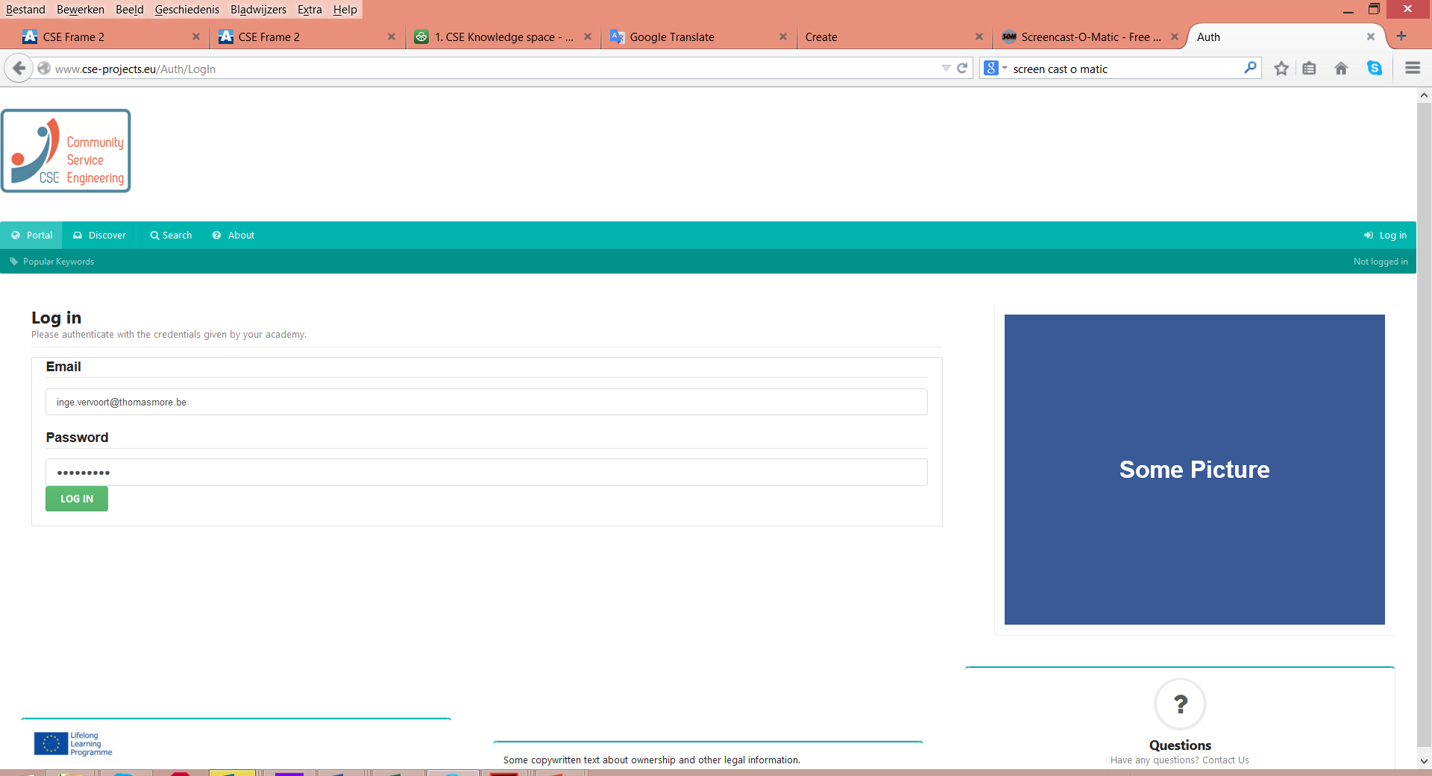
How?
Log in to the database – login is provided
http://www.cse-projects.eu/
Notes:
P 160

Slide 7
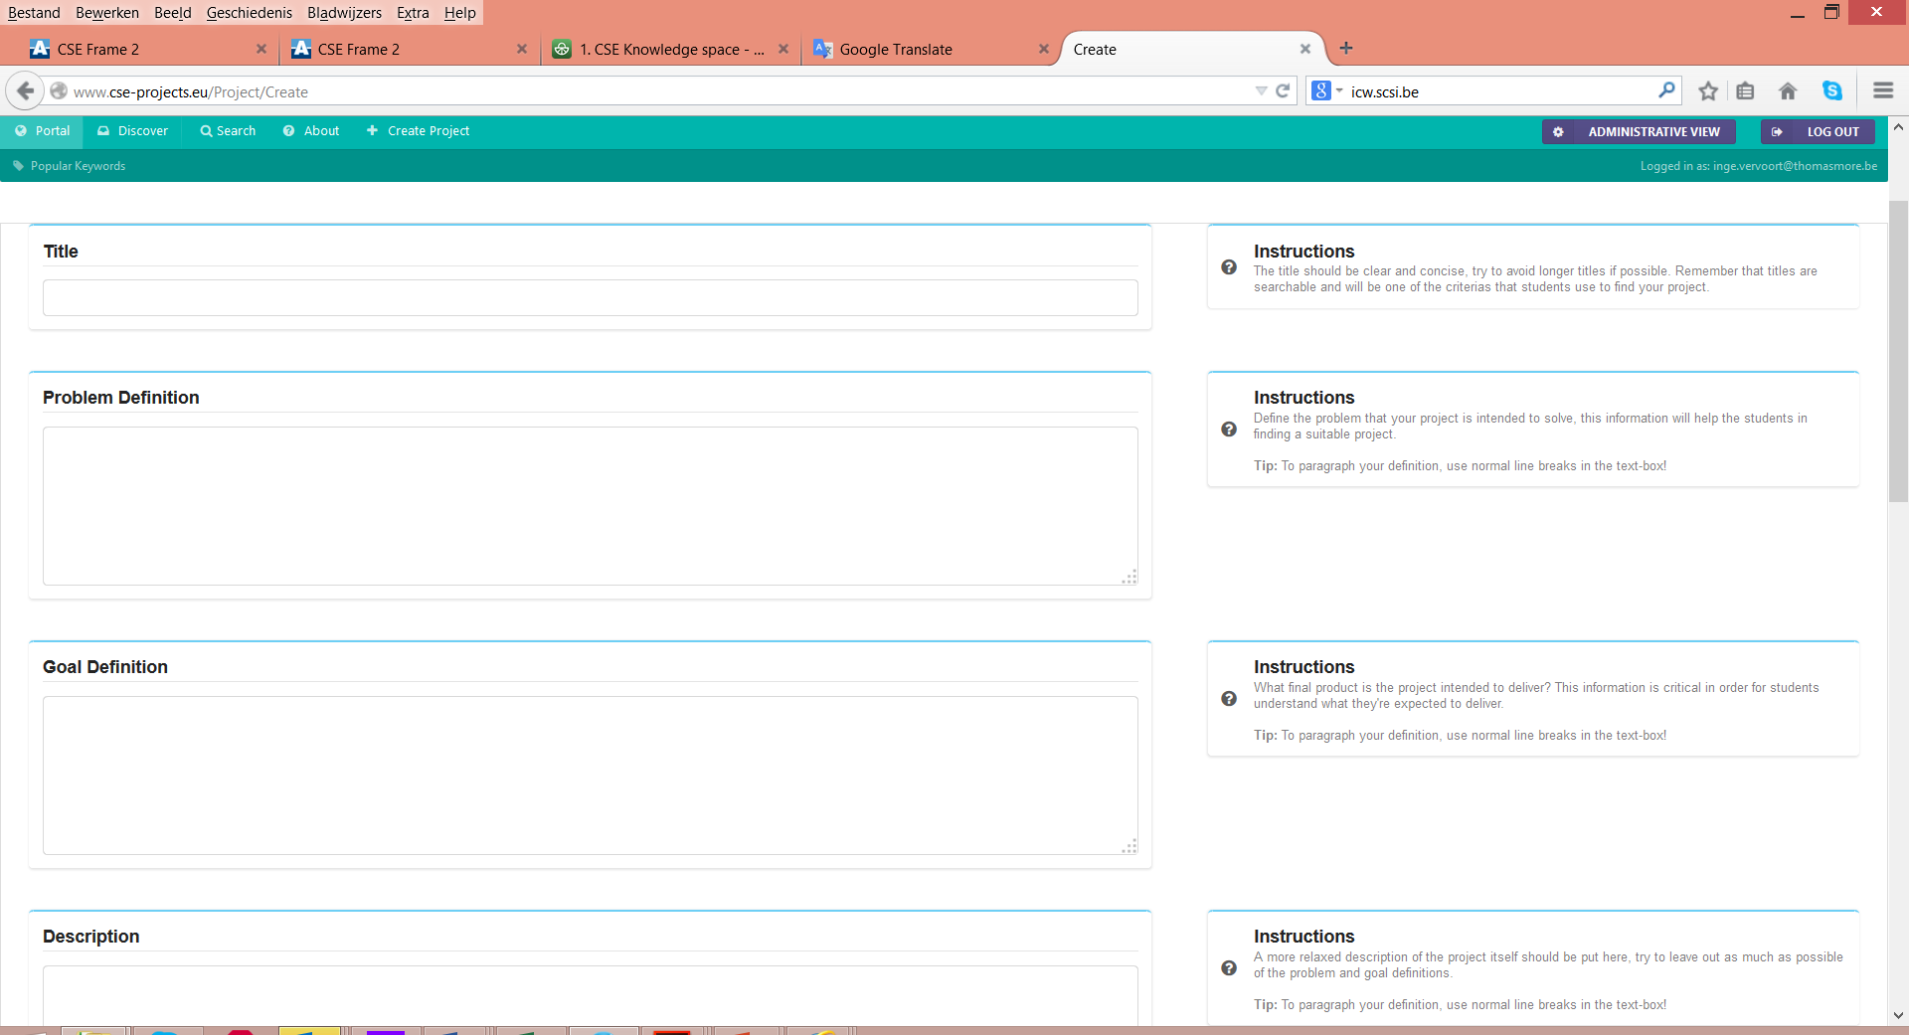
How?
Click the button create project
Notes:
P 160

Slide 8
How?
Enter the following data:
A title
The problem definition
The goal definition
A description of the context
The date when the idea was first created
Status - Vacant (Other options: Planned – Ongoing – Finished)
The Country of Origin
The type of Project promotor (options: business/non profit organisation/research group/umbrella organisation)
The engineering discipline that would have the ‘ideal’ background to solve this problem
Minimally two keywords that refer to one of the two CSE frames
Notes:
P 160

Slide 9
What’s next?
A student chooses one of the projects
You (as administrator) change the statuses into Planned – Ongoing – Finished
You stimulate your student to use the Template Design workbook
You add the URL to the students porfolio to the projects database
Notes:
P 160

Slide 10
Only once?
Could a project idea only be picked up once?
Notes:
P 160

